Slide 1
ZERO-COST REVENUE ENGINE
AI-Powered Sales Outreach Automation
Name: Sweta Pramanick
Roll Number: 25500123176
College: Dr Sudhir Chandra Sur Institute of Technology & Sports Complex
Department: BTech in Computer Science & Engineering
Session: 2023-27

Slide 2
Project Overview
Objective: Automate B2B sales outreach with AI-powered personalization
Process: Data Extraction → AI Enrichment → Email Personalization → SMTP Dispatch
Cost: Zero infrastructure costs using free APIs (Google Gemini, Gmail)
Scalability: Process hundreds of leads with minimal effort
Time-Saving: Reduces manual outreach time by 90%
Demo: https://zero-cost-revenue-engine.onrender.com/ https

Slide 3
Problem Statement
❌ Traditional sales outreach is time-consuming and resource-intensive
❌ Manual research required for each prospect
❌ Generic email templates have low engagement rates
❌ High costs for sales tools and services
✅ Solution: Automated, intelligent, cost-free outreach platform

Slide 4
Key Features
• Automated Lead Ingestion
• Web Scraping & Data Extraction
• Metadata Enrichment
• SQL Database Integration
• Google Gemini AI Integration
• Personalized Email Generation
• SMTP Email Dispatch
• Real-time Pipeline Tracking

Slide 5
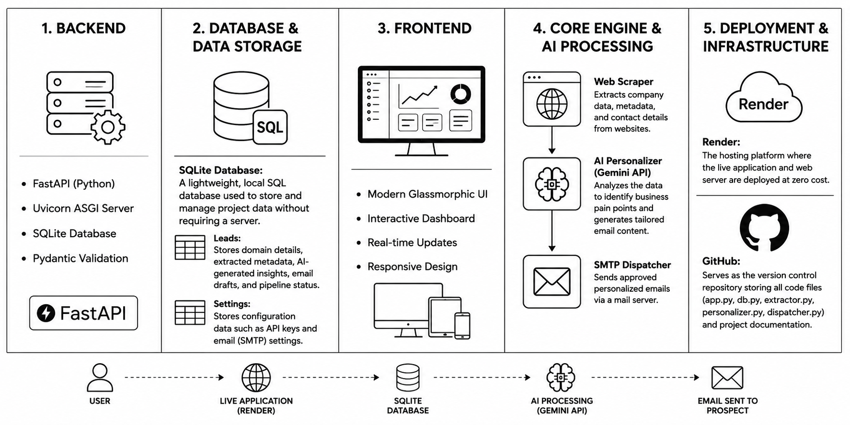
Technology Stack

Slide 6
This system follows a simple pipeline: Lead Input → Data Extraction → AI Personalization → Approval → Email Sending
API Architecture
Method | Endpoint | Description
GET | /api/leads | Fetch all stored leads
POST | /api/leads/ingest | Extract and save lead data from domain
POST | /api/leads/{id}/personalize | Generate AI-powered email content
POST | /api/leads/{id}/approve | Send email via SMTP
GET/POST | /api/settings | Manage API keys & SMTP configuration

Slide 7
Pipeline Architecture
Stage 1: Data Extraction
• Scrape domain metadata, emails, company info
Stage 2: Enrichment & Storage
• Store extracted data in relational database
Stage 3: AI Personalization
• Use Google Gemini to identify pain points and generate copy
Stage 4: Human Gate (Approval)
• Operator reviews and sends email via SMTP
lead = db.get_lead(lead_id)
metadata = extract_domain_metadata(lead['domain'])
db.update_lead_enrichment(lead_id, metadata, status='Enriched')
ai_data = generate_personalized_content(company, domain, metadata)
db.update_lead_ai_output(lead_id, ai_data, status='Pending_Review')

Slide 8
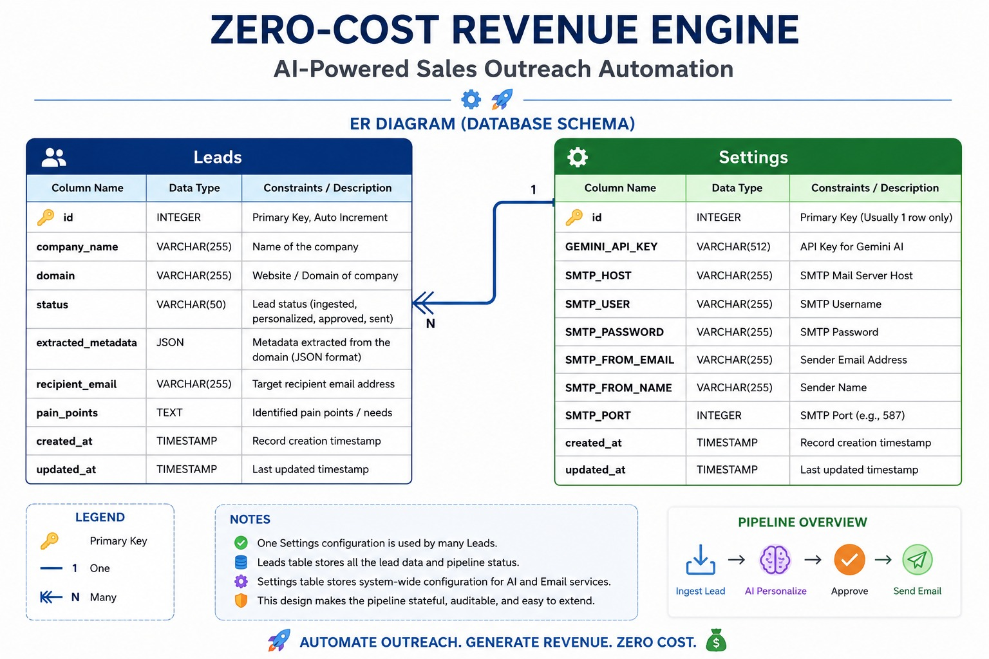
Database Schema

Slide 9
Frontend Dashboard
Left Pane: Lead Management
• Quick ingestion form for domain entry
• Filterable leads pipeline view
• Status-based organization (Discovered, Enriched, Pending, Sent, Failed)
Right Pane: Detail Workspace
• Email editor with recipient, subject, body fields
• AI insights tab showing identified pain points
• Metadata tab displaying scraped information

Slide 10
User Workflow
Step 1: Enter company domain
Step 2: System extracts metadata
Step 3: AI analyzes and generates
Step 4: Review in dashboard
Step 5: Edit if needed
Step 6: Approve email
Step 7: System sends via SMTP
Step 8: Lead marked complete
Step 9: Tack results in stats
Step 10: Scale to hundreds of leads

Slide 11
Live Demo
🌐 Live Application:
https://zero-cost-revenue-engine.onrender.com/
📊 Current Features:
• Real-time lead ingestion and processing
• Background pipeline execution
• Email draft editing and approval
• Live statistics dashboard
• System settings configuration

Slide 12
GitHub Repository
📦 Source Code & Documentation:
https://github.com/swetapramanick-ml/zero-cost-revenue-engine
📁 Repository Structure:
• app.py - FastAPI main application
• db.py - Database operations & schema
• extractor.py - Web scraping module
• personalizer.py - Gemini AI integration
• dispatcher.py - SMTP email sending

Slide 13
Results & Impact
Business Metrics:
• Higher open rates (personalization)
• Lower bounce rates
• Scalable to 1000+ leads
• Repeatable, automated process
Efficiency Gains:
• 90% time reduction per prospect
• 0 infrastructure costs
• 100% personalized emails
• Instant deployment

Slide 14
Future Enhancements
🔮 Multi-channel outreach (LinkedIn, Twitter, SMS)
📊 Advanced analytics and A/B testing
🤖 Natural language processing for better targeting
🔐 Enterprise-grade security and audit logs
📱 Mobile application for lead management on-the-go
🌍 Internationalization and multi-language support

Slide 15
Thank You!
Questions & Discussion
For more information: https://github.com/swetapramanick-ml/zero-cost-revenue-engine
Live Demo: https://zero-cost-revenue-engine.onrender.com/
Contact: Sweta Pramanick - 9230746051

